Slide 1
Data Formats
Pravin Y Pawar
Adapted from Designing Machine Learning Systems by Chip Huyen

Slide 2
Data Sources
An ML system can work with data from many different sources
have different characteristics with different access patterns
can be used for different purposes
and require different processing methods
Understanding the sources of data can help access and manipulate data more efficiently

Slide 3
Data Sources(2)
User Generated data
One common source is user input data, data explicitly input by users, which is often the input on
which ML models can make predictions
can be texts, images, videos, uploaded files, etc.
If there are wrong way for humans to input data, humans are going to do it, and as a result, user
input data can be easily mal-formatted
If user input is supposed to be
texts, they might be too long or too short
numerical values, users might accidentally enter texts
fie uploading, they might upload files in the wrong formats
Challenges
User input data requires more heavy-duty checking and processing
Users also have little patience. In most cases, when we input data, we expect to get results back immediately
Therefore, user input data tends to require fast processing.

Slide 4
Data Sources(3)
System-generated data
Data generated by different components of systems,
which include various types of logs and system outputs such as model predictions
Logs
Can record the state of the system and significant events in the system, such as memory usage, number of instances, services called, packages used,
etc. Can record the results of different jobs, including large batch jobs for data processing and model training
Provides visibility into how the system is doing, and the main purpose of this visibility is for debugging and possibly improving the application
Much less likely to be mal-formatted as its system generated
Don’t need to be processed as soon as they arrive
acceptable to process logs periodically, such as hourly or even daily
might still want to process logs fast to be able to detect and be notified whenever something interesting happens
Because debugging ML systems is hard,
Common practice to log everything you can
Means volume of logs can grow very, very quickly
Leads to two problems
The first is that it can be hard to know where to look because signals are lost in the noise
Many services that process and analyze logs, such as Logstash, DataDog, Logz, etc.
The second problem is how to store a rapidly growing amount of logs
In most cases, store logs for as long as they are useful, and can discard them when they are no longer relevant
Can also be stored in low-access storage that costs much less than higher-frequency-access storage

Slide 5
Data Sources(4)
System-generated users data
Users’ behaveiors
such as clicking, choosing a suggestion, scrolling, zooming, ignoring a popup, or spending an unusual amount of time on certain pages
system-generated data, it’s still considered part of user data
might be subject to privacy regulations
Can be used for ML systems to make predictions and to train their future versions
Internal databases
generated by various services and enterprise applications in a company
manage their assets such as inventory, customer relationship, users, and more
can be used by ML models directly or by various components of an ML system
For example,
when users enter a search query on Amazon, one or more ML models will process that query to detect the intention of that query — what products users are actually looking for? — then Amazon will need to check their internal databases for the availability of these products before ranking them and showing them to users.

Slide 6
Data Sources(5)
Third-party data - wonderfully weird world
Types of data
First-party data is the data that company already collects about users or customers
Second-party data is the data collected by another company on their own customers that they make available to you
Third-party data companies collect data on the public who aren’t their customers
The rise of the Internet and smartphones has made it much easier for all types of data to be collected
Riddled with privacy concerns
Data from apps, websites, check-in services, etc. are collected and (hopefully) anonymized to generate
activity history for each person
Third-party data is usually sold as structured data after being cleaned and processed by vendors.

Slide 7
Data Formats
Need
Once have data, need to store data (or “persist” it, in technical terms)!
Since data comes from multiple sources with different access patterns
storing your data isn’t always straightforward and can be costly
important to think about how the data will be used in the future so that the format will make sense
Questions needs to be considered
How do I store multimodal data?
When each sample might contain both images and texts?
Where to store your data so that it’s cheap and still fast to access?
How to store complex models so that they can be loaded and run correctly on different hardware?
Data serialization
The process of converting a data structure or object state into a format that can be stored or transmitted and reconstructed later
Many data serialization formats
When considering a format to work with, need to consider different characteristics such as
human readability
access patterns
and whether it’s based on text or binary, which influences the size of its files

Slide 8
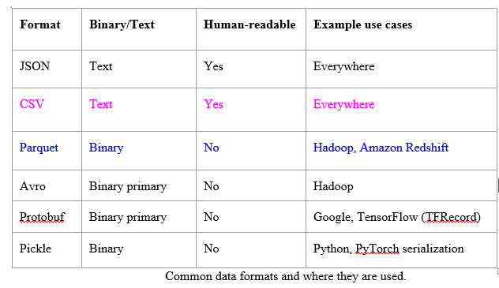
Data Formats(2)
Common data formats

Slide 9
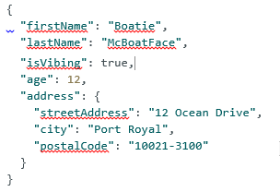

Data Formats(3)
JSON
JSON, JavaScript Object Notation, is everywhere
Though it was derived from JavaScript, it’s language-independent — most modern programming languages can generate and parse JSON
Human-readable
Key-value pair paradigm is simple but powerful, capable of handling data of different levels of structuredness
For example, persons data can be stored in a structured format like the following
The same data can also be stored in an unstructured blob of text like the following

Slide 10
Data Formats(4)
Row-major vs. Column-major Format
Two common formats that represents distinct paradigms are CSV and Parquet
CSV is row-major, which means consecutive elements in a row are stored next to each other in memory
Parquet is column-major, which means consecutive elements in a column are stored next to each other
Modern computers process sequential data more efficiently than non-sequential data
If a table is row-major, accessing its rows will be faster than accessing its columns in expectation
For row-major formats, accessing data by rows is expected to be faster than accessing data by columns
Column-major formats allow flexible column-based reads, especially if data is large with thousands, if not millions, of features
Row-major formats allow faster data writes
Overall,
row-major formats are better when you have to do a lot of writes
column-major ones are better when you have to do a lot of column-based reads.

Slide 11
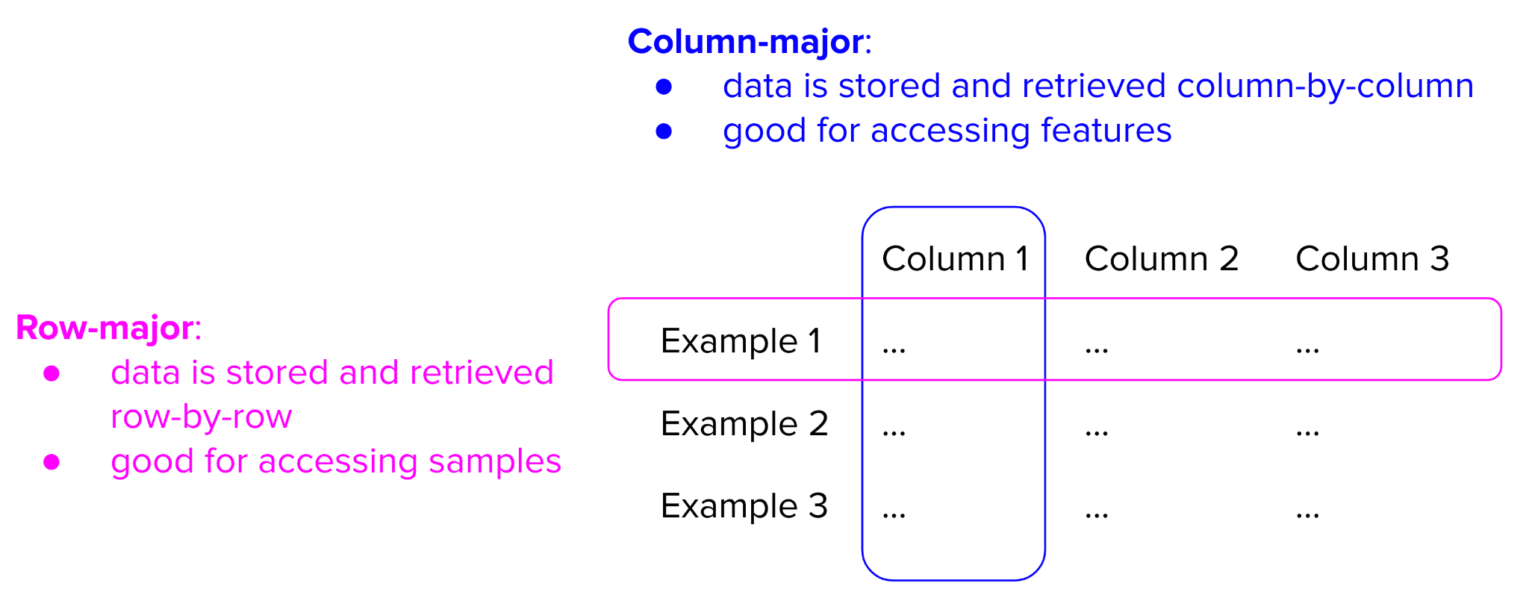
Data Formats(5)
Row-major vs. Column-major Format

Slide 12
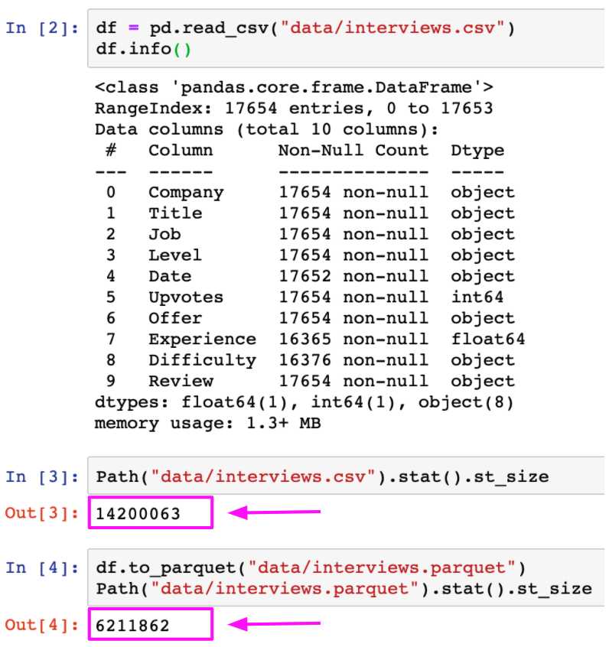
Data Formats(6)
Text vs. Binary Format
CSV and JSON are text files whereas Parquet files are binary files
Text files are files that are in plain text, which usually mean they are human-readable
Binary files are files that contain 0’s and 1’s, and meant to be read or used by programs that know how to interpret the raw bytes
A program has to know exactly how the data inside the binary file is laid out to make use of the file
Binary files are more compact.
AWS recommends using the Parquet format because
“the Parquet format is up to 2x faster to unload and consumes up to
6x less storage in Amazon S3, compared to text formats.”

Slide 13
Thank You!
In our next session:

